Slide 1
B+ - Tree & B - Tree
By Phi Thong Ho

Slide 2
Agenda
B+ - Tree Structure
B+ - Tree Updates
B+ - Tree File Organization
B - Tree Index Files

Slide 3
B+ - Tree Structure
A B+ - Tree is in the form of a balanced tree in which every path from the root of the tree to a leaf of the tree is the same length.
Each nonleaf node in the tree has between [n/2] and n children, where n is fixed.
B+ - Trees are good for searches, but cause some overhead issues in wasted space.

Slide 4
A typical node contains up to n – 1 search key values K1, K2,…, Kn-1, and n pointers P1, P2,…, Pn. The search key values are kept in sorted order.
P1 K1 P2 … Pn-1 Kn-1 Pn

Slide 5
The pointer Pi can point to either a file record or a bucket of pointers which each point to a file record.
leaf node, n = 3
Brighton Downtown
A – 212 Brighton 750
A – 101 Brighton 750
A – 212 Brighton 750
.
.
.

Slide 6
Each leaf can hold up to n – 1 values and must contain at least [(n – 1) / 2] values.
Nonleaf node pointers point to tree nodes (leaf nodes). Nonleaf nodes can hold up to n pointers and must hold at least [n/2] pointers.
i.e. n = 3
Perryridge
Mianus
Redwood
Brighton Downtown
Mianus
Redwood Round Hill
Perryridge

Slide 7
B+ - Tree Updates
Insertion – If the new node has a search key that already exists in another leaf node, then it adds the new record to the file and a pointer to the bucket of pointers. If the search key is different from all others, it is inserted in order.
Deletion – It removes the search key value from the node.

Slide 8
i.e. we are going to insert a node with a search key value “Clearview”. We find that “Clearview” should be in the node with Brighton and Downtown, so we must split the node.
i.e. n = 3
Perryridge
Downtown Mianus
Redwood
Brighton Clearview
Mianus
Redwood Round Hill
Perryridge
Downtown

Slide 9
i.e. Deletion of “Downtown” from slide #8.
Perryridge
Mianus
Redwood
Brighton Clearview
Mianus
Redwood Round Hill
Perryridge

Slide 10
i.e. Deletion of “Perryridge” from slide #8
Mianus
Downtown
Redwood
Brighton Clearview
Mianus
Redwood Round Hill
Downtown

Slide 11
B+ - Tree File Organization
In a B+ - Tree file organization, the leaf nodes of the tree stores the actual record rather than storing pointers to records.
During insertion, the system locates the block that should contain the record. If there is enough free space in the node then the system stores it. Otherwise the system splits the record in two and distributes the records.
During deletion, the system first removes the record from the block containing it. If the block becomes less than half full as a result, the records in the block are redistributed.

Slide 12
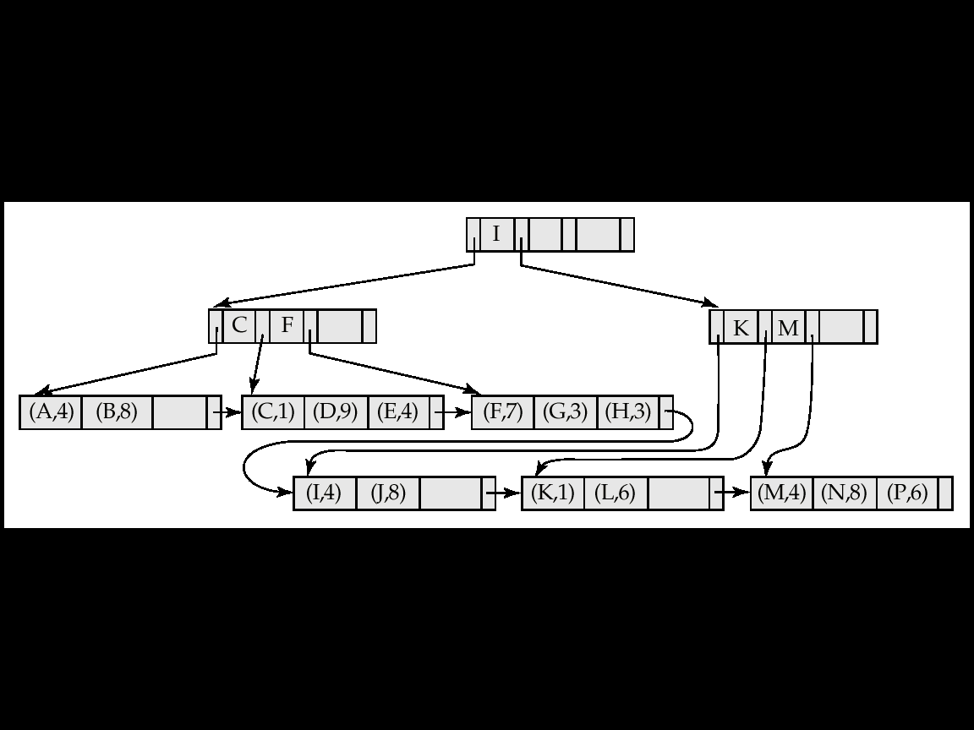
B+ - Tree File Organization

Slide 13
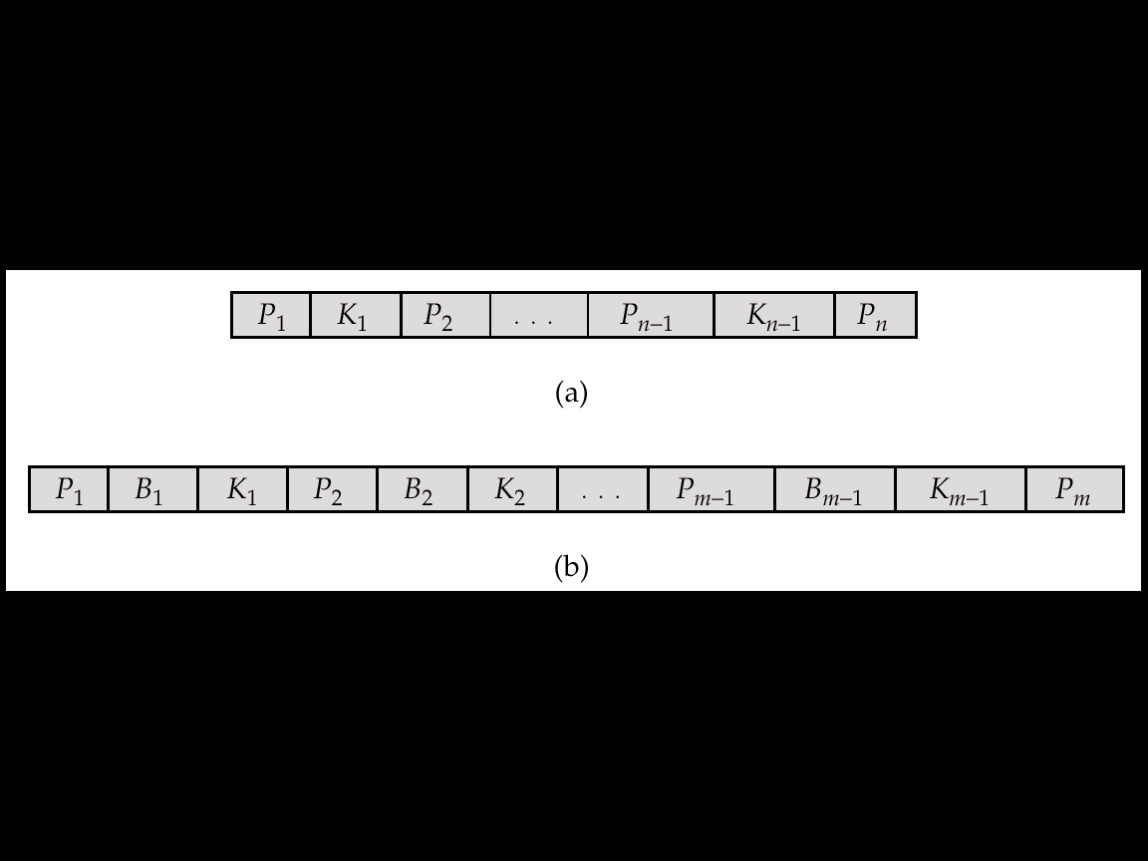
B - Tree Index Files
Similar to B+-tree, but B-tree allows search-key values to appear only once; eliminates redundant storage of search keys.
Search keys in nonleaf nodes appear nowhere else in the B-tree; an additional pointer field for each search key in a nonleaf node must be included.
Nonleaf node – pointers B_{i} are the bucket or file record pointers.

Slide 14
B – Tree Index Files
Advantages of B-Tree indices:
  May use less tree nodes than a corresponding B⁺-Tree.
  Sometimes possible to find search-key value before reaching leaf node.
Disadvantages of B-Tree indices:
  Only small fraction of all search-key values are found early
  Non-leaf nodes are larger, so fan-out is reduced. Thus B-Trees typically have greater depth than corresponding
  B⁺-Tree
  Insertion and deletion more complicated than in B⁺-Trees
  Implementation is harder than B⁺-Trees.

Slide 15
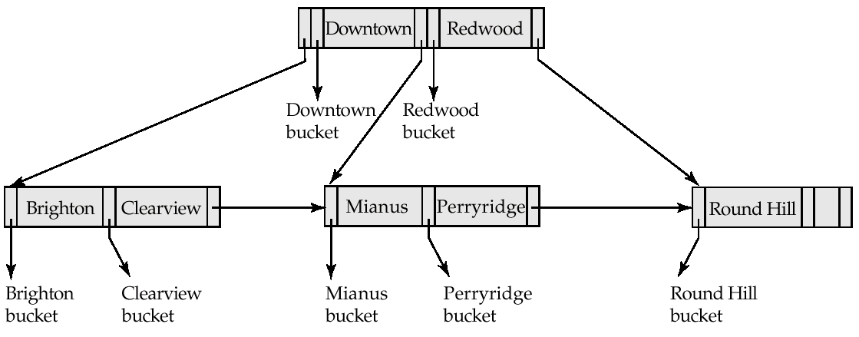
Example of B – Tree

